Slide 1


Analysis of Next Generation Sequence Data
02/13/2019
Qi Yan
Department of Pediatrics
Children’s Hospital of Pittsburgh of UPMC
University of Pittsburgh

Slide 2
Last Lecture
Genome-wide association study has identified thousands of disease-associated loci
Large consortium performs meta-analysis to further increase the sample size (power) to detect additional loci
GWAS is limited by the chip design and rare variants are rarely explored

Slide 3
Outline
Background of DNA sequencing
From sequence data to genotype
Rare variant tests
Notes:
This is the outline for today’s lecture. I will firstly talk a little bit background DNA sequencing. Then I’ll talk about the algorithm from sequence data to genotypes. Finally I’ll introduce a few of methods for rare variant test.

Slide 4
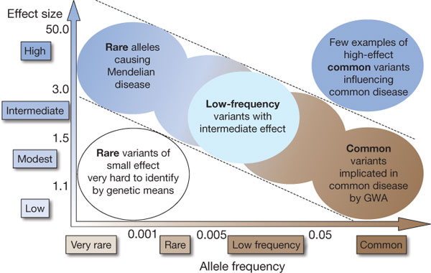
Genetic Spectrum of Complex Diseases
Linkage
Sequencing
GWAS
Notes:
We have talked about using GWAS to identify common genetic variants in the last lecture. Today, I’ll talk about how to use the latest sequencing technology to genotype both common and rare genetic variants, and apply appropriate statistical methods to analyze rare genetic variants.

Slide 5
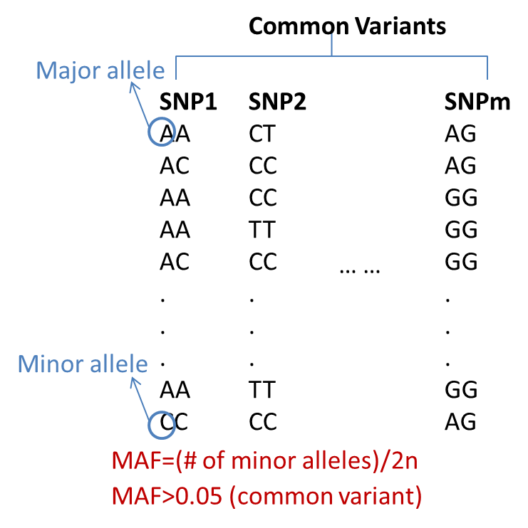
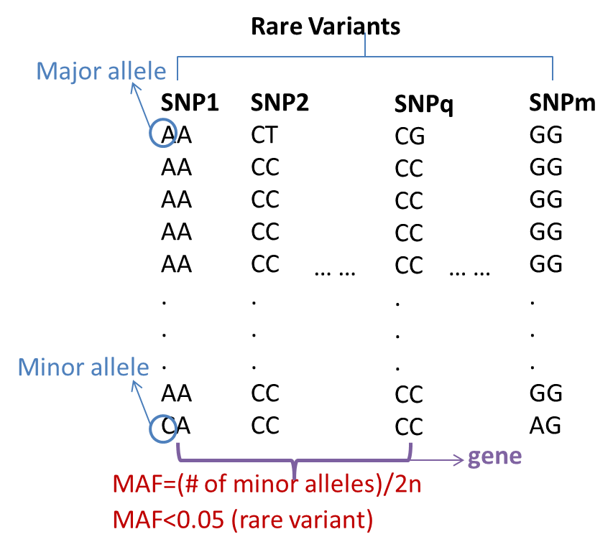
Common VS Rare
Genotypes:
Common variants (e.g. MAF≥0.05): single marker test;
Rare variants (e.g. MAF<0.05): test at gene level
Only subset of functional elements include common variants
Rare variants are more numerous and thus will point to additional associated loci
Notes:
So, let’s look at the difference between common and rare variants. Common variants are the SNPs with relatively high MAF, such as greater than 0.05. Rare variants are the SNPs with low MAF, such as less than 0.05. Some people use 0.01. A is the major allele in SNP1, because …

Slide 6


Association Study in Case Control Samples
SNP1
↓
SNP2
↓
SNP3
↓
SNP4
↓
CAGATCGCTGGATGAATCGCATC
CGGATTGCTGCATGGATCGCATC
CAGATCGCTGGATGAATCGCATC
CAGATCGCTGGATGAATCCCATC
CGGATTGCTGCATGGATCCCATC
CGGATTGCTGCATGGATCCCATC
SNP5
↓
Disease
Gene
Notes:
We can use GWAS to study the association between diseases and each of these genetic markers, but this only works well for common variants.

Slide 7
Sequencing Cost
http://www.genome.gov/
Notes:
The sequencing cost per genome is getting cheaper and cheaper, which allow us to sequence more samples. The sample size is important for statistical studies.
Moore's law is the observation that over the history of computing hardware, the number of transistors on integrated circuits doubles approximately every two years.

Slide 8
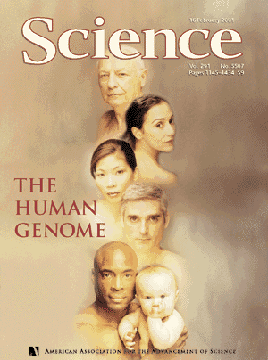


A Road to Discover Human Genome
A lot of efforts have been made to discover and understand human genome.
In the past 20 years, several projects involving multiple countries have been finished or on progress.
The Human Genome Project identifies 20,000-25,000 genes in human DNA, determine the sequences of the 3 billion chemical base pairs that make up human DNA and boost the sequencing technology in industry.
The HapMap Project determines the common patterns of DNA sequence variation in the human genome from populations with ancestry from Africa, Asia and Europe.
The One Thousand Genome Project sequenced the genomes of more than 1,000 individuals from more than 10 different ethnic groups using next-generation sequencing technology and provide a much deeper catalog of human genetic variation.
Notes:
A lot of efforts have been made to discover and understand human genome after James Watson and Francis Crick discovered the double helix structure of DNA in 1953. In the past twenty years, several projects involving multiple countries have been finished or on progress.
The human genome project identify all the approximately 20,000-25,000 genes in human DNA, determine the sequences of the 3 billion chemical base pairs that make up human DNA and boost the sequencing technology in industry.
The International HapMap Project is a multi-country effort to identify and catalog genetic similarities and differences in human beings.
The recent one thousand genome project plans to sequence the genomes of at least one thousand individuals from more than 10 different ethnic groups using next-generation sequencing technology and provide a much deeper catalog of human genetic variation. This project is lead by Dr. Abescacis…
Human Genonme Project (1990-2003)
identify all the approximately 20,000-25,000 genes in human DNA,
determine the sequences of the 3 billion chemical base pairs that make up human DNA,
store this information in databases,
improve tools for data analysis,
transfer related technologies to the private sector, and
address the ethical, legal, and social issues (ELSI) that may arise from the project.
COVER The face of the human genome. A scientific milestone of enormous proportions, the sequencing of the human genome will impact all of us in diverse ways-from our views of ourselves as human beings to new paradigms in medicine. This entire issue is devoted to the scientific announcement of the sequencing of the human genome, initial analyses of the genome and genomic data, as well as Viewpoints and News features discussing the implications of the results and paths for the future.
The goal of the International HapMap Project is to determine the common patterns of DNA sequence variation in the human genome and to make this information freely available in the public domain. An international consortium is developing a map of these patterns across the genome by determining the genotypes of one million or more sequence variants, their frequencies and the degree of association between them, in DNA samples from populations with ancestry from parts of Africa, Asia and Europe. The
HapMap will allow the discovery of sequence variants that affect common disease, will facilitate development of diagnostic tools, and will enhance our ability to choose targets for therapeutic intervention.
The International HapMap Project is a multi-country effort to identify and catalog genetic similarities and differences in human beings. Using the information in the HapMap, researchers will be able to find genes that affect health, disease, and individual responses to medications and environmental factors.
1000 Genome Project
The 1000 Genomes Project is an international collaboration to produce an extensive public catalog of human genetic variation, including SNPs and structural variants, and their haplotype contexts. This resource will support genome-wide association studies and other medical research studies.

Slide 9
Next Generation Sequencing
Commercial platforms produce gigabases of sequence rapidly and inexpensively
ABI SOLiD, Illumina Solexa, Roche 454, Complete Genomics, and others…
Sequence data consist of thousands or millions of short sequence reads with moderate accuracy 0.5 – 1.0% error rates per base may be typical
High-throughput but hard to assemble
Notes:
About

Slide 10
A Typical Pipeline
Shotgun Sequencing Reads
Read
Alignment Software
Mapped Reads
Single Marker Caller
Polymorphic Sites
Haplotype-based
Caller
Individual Genotypes
Notes:
This is a pipeline for genotyping an individual’s genome. …considering the genotypes of the SNPs in the neighborhood.

Slide 11
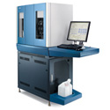
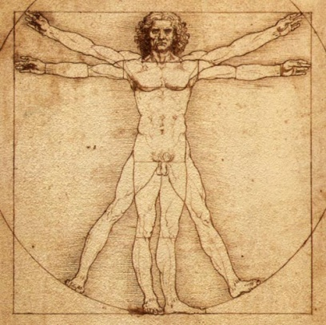
Short read alignment
Sequencer
Human source
Reads from sequencing machines are short: 30-400 bp
Notes:
Use shot gun technology to sequence read.

Slide 12
Short read alignment
And you get MILLIONS of them
Sequencing machine
Notes:
1.6 billion for a 20x resequencing of the human genome!

Slide 13
Short read alignment
Need to map them back to human reference
Notes:
Human genome project

Slide 14
Alignment
Reference sequence:
actgtagattagccgagtagctagctagtcgat
Find best match for each read in a reference sequence
Challenges:
ccgagaagctag
Hashing is time and memory consuming for millions of reads and billion-base long reference
Errors in reads
Each read may be mapped to multiple positions
Individual polymorphisms
Notes:
For alignment, we want to find the best …
Challenges:
====================
Lots of comparisons to be made! Computation.
Errors in reads
Repetitive regions; Each read may be mapped to multiple positions
Individual polymorphisms

Slide 15
Existing Alignment by Category
Hashing reference genome
SOAP1, MOSAIK, PASS, BFAST, …
Hashing short reads
Eland, MAQ, SHRiMP, …
Merge-sorting reference together with reads
Slider
Based on Burrows-Wheeler Transform
BWA, SOAP2, Bowtie, …
Li and Durbin (2009), Bioinformatics 25 (14): 1754-60
Notes:
BWA paper
Other mapping algorithms
http://samtools.sourceforge.net/swlist.shtml
Burrows-Wheeler transform : data compression technique. 1994 bzip2

Slide 16
After Alignment
Each read is mapped to reference genome with tolerated number of mismatches
Mismatches allow us to discover the individual variation
Each site of reference genome is covered by multiple un-evenly distributed reads
Some sites might not be covered

Slide 17
Coverage (High vs Low)
Reads
Genome 1
VS
Genome 2
Genome
Genome 3
Genome 4
Which one has more power to detect variations?
Notes:
There is a debate.

Slide 18
Different Approaches
Deep whole genome sequencing
Expensive, only can be applied to limited samples currently
Most complete ascertainment of all variations
Low coverage whole genome sequencing
Modest cost, typically 100-1000 samples
Complete ascertainment of common variations
Less compete ascertainment of rare variants
Exome capture and targeted region sequencing
Modest cost, high coverage
Most interesting part of the genome

Slide 19
Genotype Calling
Types of study
Population-based (unrelated samples)
Family-based (multiple families)
Types of method
Single sample, single site
Multiple samples, single site
Multiple samples, multiple sites
Notes:
For in terms of

Slide 20
Genotype Calling
One of the most important steps in next generation sequencing downstream analysis is genotype inference
The essential question in genotype calling is:
P(G|R)
where R denotes base call at all loci, G denotes hypothetical true genotype

Slide 21
Genotype Calling from Sequence Data
TAGCTGATAGCTAGATAGCTGATGAGCCCGAT
ATAGCTAGATAGCTGATGAGCCCGATCGCTGCTAGCTC
ATGCTAGCTGATAGCTAGCTAGCTGATGAGCC
AGCTGATAGCTAGCTAGCTGATGAGCCCGATCGCTG
GCTAGCTGATAGCTAGCTAGCTGATGAGCCCGA
Sequence Reads
5’-ACTGGTCGATGCTAGCTGATAGCTAGCTAGCTGATGAGCCCGATCGCTGCTAGCTCGACG-3’
Reference Genome
2A and 3C
Observed Data
A/C or A/A or C/C
Predicted Genotype
Notes:
After mapping reads to the reference genome, we need to call the genotypes of SNPs. For example, we want to call the genotypes of this SNP.

Slide 22
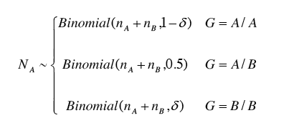
A Simple Model
At one site, n_{A} reads carry A, n_{B} reads carry B
# of reads carrying A
total # of reads
Notes:
Given the true G, what is the probability of NA

Slide 23
Inference with no reads
Sequence Reads
5’-ACTGGTCGATGCTAGCTGATAGCTAGCTAGCTGATGAGCCCGATCGCTGCTAGCTCGACG-3’
Reference Genome
P(reads|A/A)= 1.0
P(reads|A/C)= 1.0
P(reads|C/C)= 1.0
Possible Genotypes
Notes:
When we have no reads, the probability given ANY true underlying genotype is 1.

Slide 24
Inference with short read data
GCTAGCTGATAGCTAGCTAGCTGATGAGCCCGA
Sequence Reads
5’-ACTGGTCGATGCTAGCTGATAGCTAGCTAGCTGATGAGCCCGATCGCTGCTAGCTCGACG-3’
Reference Genome
P(reads|A/A)= P(C observed, read maps |A/A)
P(reads|A/C)= P(C observed, read maps |A/C)
P(reads|C/C)= P(C observed, read maps |C/C)
Possible Genotypes
Notes:
A binomial distribution

Slide 25
Inference assuming error of 1%
GCTAGCTGATAGCTAGCTAGCTGATGAGCCCGA
Sequence Reads
5’-ACTGGTCGATGCTAGCTGATAGCTAGCTAGCTGATGAGCCCGATCGCTGCTAGCTCGACG-3’
Reference Genome
P(reads|A/A)= 0.01
P(reads|A/C)= 0.50
P(reads|C/C)= 0.99
Possible Genotypes

Slide 26
As data accumulate …
AGCTGATAGCTAGCTAGCTGATGAGCCCGATCGCTG
GCTAGCTGATAGCTAGCTAGCTGATGAGCCCGA
Sequence Reads
5’-ACTGGTCGATGCTAGCTGATAGCTAGCTAGCTGATGAGCCCGATCGCTGCTAGCTCGACG-3’
Reference Genome
P(reads|A/A)= 0.01*0.01=0.0001
P(reads|A/C)= 0.5*0.5=0.25
P(reads|C/C)= 0.99*0.99=0.98
Possible Genotypes

Slide 27
As data accumulate …
ATGCTAGCTGATAGCTAGCTAGCTGATGAGCC
AGCTGATAGCTAGCTAGCTGATGAGCCCGATCGCTG
GCTAGCTGATAGCTAGCTAGCTGATGAGCCCGA
Sequence Reads
5’-ACTGGTCGATGCTAGCTGATAGCTAGCTAGCTGATGAGCCCGATCGCTGCTAGCTCGACG-3’
Reference Genome
P(reads|A/A)= 0.01*0.01*0.01=0.000001
P(reads|A/C)= 0.5*0.5*0.5=0.125
P(reads|C/C)= 0.99*0.99*0.99=0.97
Possible Genotypes

Slide 28
As data accumulate …
TAGCTGATAGCTAGATAGCTGATGAGCCCGAT
ATGCTAGCTGATAGCTAGCTAGCTGATGAGCC
AGCTGATAGCTAGCTAGCTGATGAGCCCGATCGCTG
GCTAGCTGATAGCTAGCTAGCTGATGAGCCCGA
Sequence Reads
5’-ACTGGTCGATGCTAGCTGATAGCTAGCTAGCTGATGAGCCCGATCGCTGCTAGCTCGACG-3’
Reference Genome
P(reads|A/A)= 0.01*0.01*0.01*0.99=0.00000099
P(reads|A/C)= 0.5*0.5*0.5*0.5=0.0625
P(reads|C/C)= 0.99*0.99*0.99*0.01=0.0097
Possible Genotypes

Slide 29
In the “end”
TAGCTGATAGCTAGATAGCTGATGAGCCCGAT
ATAGCTAGATAGCTGATGAGCCCGATCGCTGCTAGCTC
ATGCTAGCTGATAGCTAGCTAGCTGATGAGCC
AGCTGATAGCTAGCTAGCTGATGAGCCCGATCGCTG
GCTAGCTGATAGCTAGCTAGCTGATGAGCCCGA
Sequence Reads
5’-ACTGGTCGATGCTAGCTGATAGCTAGCTAGCTGATGAGCCCGATCGCTGCTAGCTCGACG-3’
Reference Genome
P(reads|A/A)= 0.00000098
P(reads|A/C)= 0.03125
P(reads|C/C)= 0.000097
Notes:
Individual Based Prior: Every site has 1/1000 probability of varying or so.
Population Based Prior: Use frequency information from examining others at the same site.
Haplotype Based Prior: Examine other chromosomes that are similar at locus of interest.

Slide 30
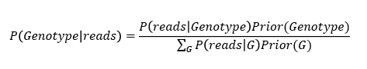
Not the “end” yet
TAGCTGATAGCTAGATAGCTGATGAGCCCGAT
ATAGCTAGATAGCTGATGAGCCCGATCGCTGCTAGCTC
ATGCTAGCTGATAGCTAGCTAGCTGATGAGCC
AGCTGATAGCTAGCTAGCTGATGAGCCCGATCGCTG
GCTAGCTGATAGCTAGCTAGCTGATGAGCCCGA
Sequence Reads
5’-ACTGGTCGATGCTAGCTGATAGCTAGCTAGCTGATGAGCCCGATCGCTGCTAGCTCGACG-3’
Reference Genome
P(reads|A/A) = 0.00000098
P(reads|A/C) = 0.03125
P(reads|C/C) = 0.000097
Making a genotype call requires
combining sequence data with prior information
Notes:
Individual Based Prior: Every site has 1/1000 probability of varying or so.
Population Based Prior: Use frequency information from examining others at the same site.
Haplotype Based Prior: Examine other chromosomes that are similar at locus of interest.

Slide 31
Not the “end” yet
TAGCTGATAGCTAGATAGCTGATGAGCCCGAT
ATAGCTAGATAGCTGATGAGCCCGATCGCTGCTAGCTC
ATGCTAGCTGATAGCTAGCTAGCTGATGAGCC
AGCTGATAGCTAGCTAGCTGATGAGCCCGATCGCTG
GCTAGCTGATAGCTAGCTAGCTGATGAGCCCGA
Sequence Reads
5’-ACTGGTCGATGCTAGCTGATAGCTAGCTAGCTGATGAGCCCGATCGCTGCTAGCTCGACG-3’
Reference Genome
P(reads|A/A)= 0.00000098 Prior(A/A) = 0.00034 P(A/A|reads) < 0.01
P(reads|A/C)= 0.03125 Prior(A/C) = 0.00066 P(A/C|reads) = 0.175
P(reads|C/C)= 0.000097 Prior(C/C) = 0.99900 P(C/C|reads) = 0.825
Base Prior: every site has 1/1000 probability of varying
Notes:
Individual Based Prior: Every site has 1/1000 probability of varying or so.
Population Based Prior: Use frequency information from examining others at the same site.
Haplotype Based Prior: Examine other chromosomes that are similar at locus of interest.

Slide 32
Population Based Prior
TAGCTGATAGCTAGATAGCTGATGAGCCCGAT
ATAGCTAGATAGCTGATGAGCCCGATCGCTGCTAGCTC
ATGCTAGCTGATAGCTAGCTAGCTGATGAGCC
AGCTGATAGCTAGCTAGCTGATGAGCCCGATCGCTG
GCTAGCTGATAGCTAGCTAGCTGATGAGCCCGA
Sequence Reads
5’-ACTGGTCGATGCTAGCTGATAGCTAGCTAGCTGATGAGCCCGATCGCTGCTAGCTCGACG-3’
Reference Genome
P(reads|A/A)= 0.00000098 Prior(A/A) = 0.04 P(A/A|reads) < .001
P(reads|A/C)= 0.03125 Prior(A/C) = 0.32 P(A/C|reads) = 0.999
P(reads|C/C)= 0.000097 Prior(C/C) = 0.64 P(C/C|reads) = <.001
Population Based Prior: Use frequency information from examining others at the same site. E.g. P(A) = 0.2
Notes:
Individual Based Prior: Every site has 1/1000 probability of varying or so.
Population Based Prior: Use frequency information from examining others at the same site.
Haplotype Based Prior: Examine other chromosomes that are similar at locus of interest.

Slide 33
Prior Information
Individual based prior
Equal probability of showing polymorphism
1/1000 bases different from reference
Error Free and Poisson distribution
Single sample, single site
Population based prior
Estimate frequency from many individuals
Multiple sample, single site
Haplotype/Imputation based prior
Jointly model flanking SNPs, use haplotype information
Important for low coverage sequence data
Multiple samples, multiple sites
Notes:
BWA paper
Other mapping algorithms
http://samtools.sourceforge.net/swlist.shtml
Burrows-Wheeler transform : data compression technique. 1994 bzip2

Slide 34
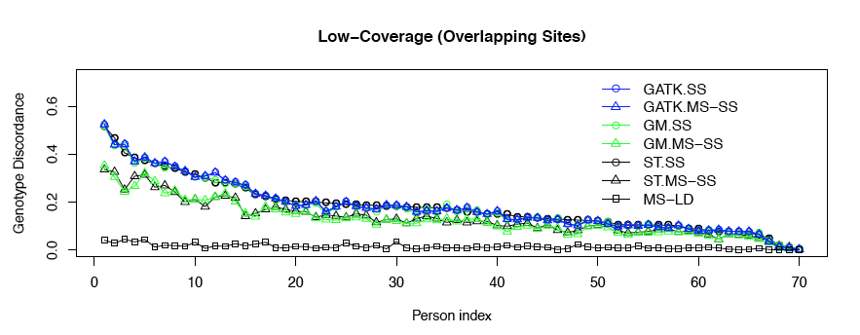
Comparisons of Different Genotype Calling Methods

Slide 35
Somatic SNPs
TAGCTGATAGCTAGATAGCTGATGAGCCCGAT
ATAGCTAGATAGCTGATGAGCCCGATCGCTGCTAGCTC
ATGCTAGCTGATAGCTAGCTAGCTGATGAGCC
AGCTGATAGCTAGCTAGCTGATGAGCCCGATCGCTG
GCTAGCTGATAGCTAGCTAGCTGATGAGCCCGA
5’-ACTGGTCGATGCTAGCTGATAGCTAGCTAGCTGATGAGCCCGATCGCTGCTAGCTCGACG-3’
P(A/C|reads) = 0.999
It’s a mutation
Reference Genome
Germline mutations (all normal cells) – occur in gametes and can be passed onto offspring (every cell in the entire organism will be affected)
Somatic mutations (tumor cells) – occur in a single body cell and cannot be inherited (only tissues derived from mutated cell are affected)
In cancer studies, we want to know if they are germline or somatic mutations in order to better understand cancer biology, diagnose cancer and improve cancer therapies

Slide 36
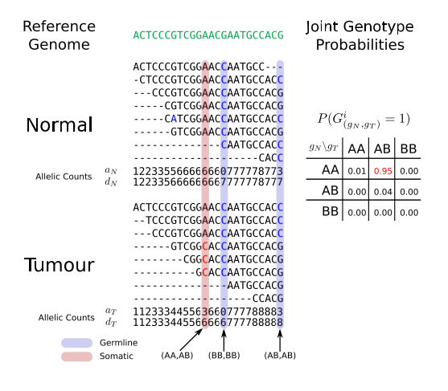
Somatic SNP calling

Slide 37
Rare Variant Tests
Genotype calling is the first step of the journey
Identify SNPs/genes associated with phenotype
Sequencing provides more comprehensive way to study the genome
Discover more rare variants
Notes:
Genotype calling is the first step of the journey. After getting these genotypes, we need to identify the SNPs associated with phenotypes. For detecting common genetic variants, we can use single marker test as what we did in GWAS. The sequencing technology provides us more rare genetic variants in addition to common variants. Then we need appropriate statistical methods to handle the rare variants.

Slide 38
Common VS Rare
Genotypes:
Common variants (e.g. MAF≥0.05): single marker test;
Rare variants (e.g. MAF<0.05): test at gene level
Only subset of functional elements include common variants
Rare variants are more numerous and thus will point to additional loci

Slide 39
Single Marker Test for Rare Variant
Rare variants are hard to detect
Rare variants have low frequency that makes single marker test less powerful
Rare causal SNPs are hard to identify even with large effect size
Notes:
Can we still use single marker test for rare variants as what we do for common variants? The answer is single marker test is not good for detecting rare variants.
Because the minor allele frequency in rare variants is low, the variation of rare variants is small. This small variation is hard to be detected by single marker test.

Slide 40
Single Marker Test for Rare Variant
Disease prevalence ~10%
Type I error 5x10⁻⁶
To achieve 80% power
Equal number of cases and controls
Minor Allele Frequency (MAF) = 0.1, 0.01, 0.001
Required sample size = 486, 3545, 34322,
Notes:
Let’s look at a power calculation example. As you can see, as the MAF is getting smaller and smaller, the required sample size for achieving good power is getting larger and larger.

Slide 41
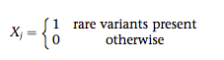

Alternatives to Single Marker Test Collapsing Method (Burden Test)
Group rare variants in the same gene/region
Score each individual
Presence or absence of rare copy
Weight each variant
Use individual score as a new “genotype”
Test in a regression framework
Notes:
Then we need alternatives to single marker test. People came up with this idea. The variation in rare variant is too small to be detected. Why don’t we collapse multiple rare variants into a new variable and this new variable should contain enough variation to be detected. Then, people collapse rare variants in the same gene into a new variable. (write down the model comparing with single marker test) Weights can be assigned to each rare variant based on prior knowledge. The traditional regression model can be used to test this new variable. This type of method is called Burden Test.

Slide 42
Burden Test
SNP1
↓
SNP3
↓
SNP4
↓
CAGATCGCTGGATGAATCGCATC
CGGATTGCTGCATGGATCGCATC
CAGATCGCTGGATGAATCGCATC
CAGATCGCTGGATGAATCCCATC
CGGATTGCTGCATGGATCCCATC
CGGATTGCTGCATGGATCCCATC
SNP2
↓
SNP5
↓
Disease
New “Genotype” = SNP1 + SNP2 + … + SNP5
New “Genotype” = W1*SNP1 + W2*SNP2 + … + W5*SNP5
Notes:
We can use GWAS to study the association between diseases and each of these genetic markers, but this only works well for common variants.

Slide 43
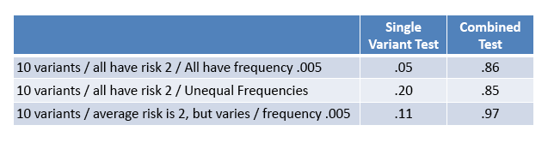
Power of Burden Test
Power tabulated in collections of simulated data
Combining variants can greatly increase power
Currently, appropriately combining variants is expected to be key feature of rare variant studies.
Notes:
These are some simulation results comparing the power performance between single marker test and the combined test. The results show that …

Slide 44
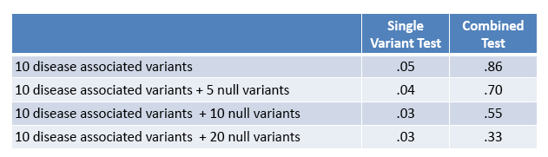
Impact of Null Variants
Including non-disease variants reduces power
Power loss is manageable, combined test remains preferable to single marker tests
Notes:
Let’s look at the impact of null variants. In different settings, different levels of noise are introduced. The results show…

Slide 45
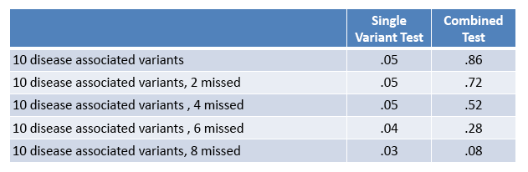
Impact of Missing Disease Alleles
Missing disease alleles reduces power
Still better than single marker test
Notes:
The impact of missing disease alleles is also checked. …

Slide 46
Challenges
Assume all causal rare variants have the same effect direction
It is hard to separate causal and null SNPs
Including all rare variants will dilute the true signals
Assume the effect size of each rare variant the same
Notes:
Burden test has some challenges. First, it assumes… which means the rare alleles in all the rare variants are either risk or protective. The effects are all in the same direction. This assumption is stringent, because it’s possible that part of the variants are risk, another part of the variants are protective. The 2nd challenge is that it is hard to separate causal and null variants, because it’s more likely only a part of the variants in a gene has effect on the disease, the others have no effect. Thus, grouping them together could introduce noise. The 3rd challenge is the effect size of each rare variant varies, but burden test assumes equal effect size across all variants. This can be improved by assigning weight to the variants.

Slide 47
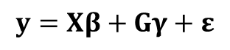
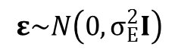
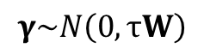
Sequence Kernel Association Test (SKAT)
Let there be n subjects with q genetic variants. The n × 1 vector of the quantitative trait y follows a linear mixed model:
$$y=Xβ+Gγ+ε$$
X is an n × p covariate matrix,
β is a p × 1 vector containing parameters for the fixed effects (an intercept and p – 1 covariates),
G is an n × q genotype matrix for the q rare genetic variants of interest,
γ is a q × 1 vector for the random effects of the q genetic variants,
ε is an n × 1 vector for the random error.
$$γ\sim N\left(0, τW\right)$$
$$ε\sim N\left(0, σ_{E}^{2}I\right)$$
where W is a predefined q × q diagonal weight matrix for each variant
Thus, the null hypothesis H₀: γ = 0 is equivalent to H₀: τ = 0, which can be tested with a variance component score test.
Wu, M. C.*, Lee, S.*, Cai, T., Li, Y., Boehnke, M., and Lin, X. (2011) Rare Variant Association Testing for Sequencing Data Using the Sequence Kernel Association Test (SKAT). American Journal of Human Genetics , 89, 82-93.
Notes:
Another popular gene based method is called sequence kernel association test. People like to call it skat. You may have heard of it. It’s really popular in recent years. This method is developed by a group at Harvard. The paper was published in 2011 and has been cited about 500 times. It’s very successful for a method paper. This is how they set up the model. … (write out the model)
This is the fancy part. In the traditional regression model, beta is a point estimate, it’s not assumed to follow any distribution. Here, the beta is assumed to be normally distributed with mean zero and variance τW, where W is the predefined weight. (Write down the beta distribution and H0 in a vector pattern). So the null hypothesis being tested is H0: beta=0, which is equivalent to test H0: τ=0 that can be tested with a variance component score test in mixed model. The random terms ε is also assumed to be normally distributed and is independent with beta.

Slide 48
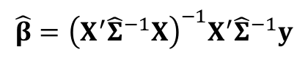
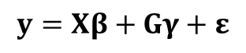
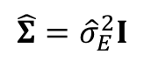
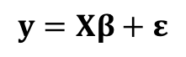
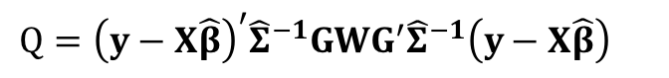
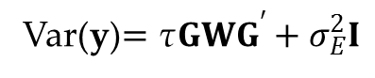
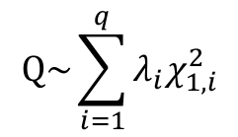
Sequence Kernel Association Test (SKAT)
$$y=Xβ+Gγ+ε$$
Var(y)$=\text{τ}GWG^{′}+σ_{E}^{2}I$
SKAT test statistic:
$${Q=\left(y−X\hat{β}\right)}^{′}{\hat{Σ}}^{−1}GWG^{′}{\hat{Σ}}^{−1}\left(y−X\hat{β}\right)$$
Called “kernel”.
Linear combination used here. Could be more flexible form.
where the parameters are estimated under H₀ (i.e., H₀: τ = 0)
Thus, under H₀:
$$y=Xβ+ε$$
$$\hat{Σ}={\hat{σ}}_{E}^{2}I$$
$$\hat{β}={\left(X^{′}{\hat{Σ}}^{−1}X\right)}^{−1}X^{′}{\hat{Σ}}^{−1}y$$
$$Q\sim \sum_{i=1}^{q}{λ_{i}χ_{1,i}^{2}}$$
Q follows a mixture of Chi-square distribution:

Slide 49
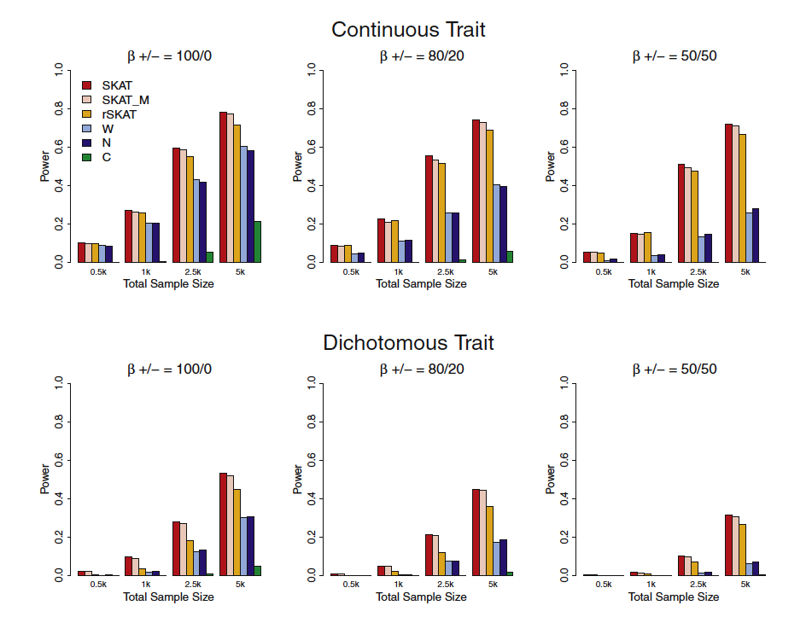
Notes:
This is the simulation results from the SKAT paper. The conclusion is SKAT is more powerful than other methods. One thing may be of interest is … these two blue ones are the burden type tests. 100/0 means …; 80/20 means …; 50/50 means… Burden test is not too bad when all the variants have the same direction of effect, but when there are different directions of effect, burden test is much less powerful.
Total sample sizes considered are 500, 1000, 2500, and 5000, with half being cases in case-control
studies. For each setting, six methods are compared: SKAT, SKAT in which 10% of the genotypes were set to missing and then imputed
(SKAT_M), restricted SKAT (rSKAT) in which unweighted SKAT is applied to variants with MAF < 3%, the weighted sum burden test (W)
with the same weights as used by SKAT, counting-based burden test (N), and the CAST method (C). All the burden tests used MAF < 3% as
the threshold. For each method, power was estimated as the proportion of p values < a among 1000 simulated data sets.

Slide 50
Discussion
Analysis of rare variants is (was?) an active research area
Weight for each SNP is the key
What to do if the samples are related
Most tests reply on permutation
Computationally intensive
Notes:
… active research area. It’s not like GWAS that has been studied too much. …In both burden test and SKAT, weight plays an important role. …When family samples are used, the relatedness needs to be appropriately handled. …Both burden test and SKAT don’t need to do permutation, so they are more efficient.

Slide 51
Reference
The 1000 Genomes Project (2010) A map of human genome vairation from population-scale sequencing. Nature 467:1061-73
Nielsen R, Paul JS et al. (2011) Genotype and SNP calling from next-generation sequencing data. Nat Rev Genet
Li Y, Chen W et al. (2012) Single Nucleotide Polymorphism (SNP) Detection and Genotype Calling from Massively Parallel Sequencing (MPS) Data. Statistics in Biosciences.
Li Y et al (2011) Low-coverage sequencing: Implication for design of complex trait association studies. Genome Research 21: 940-951
Chen W, Li B et al. (2013) Genotype calling and haplotyping in parent-offspring trios. Genome Research.

Slide 52
Reference
http://genome.sph.umich.edu/wiki/Rare_variant_tests
Raychaudhuri S. Mapping rare and common causal alleles for complex human diseases. Cell. 2011 Sep 30;147(1):57-69.
Li and Leal (2008) Am J Hum Genet 83:311-321
Madsen BE, Browning SR (2009) A Groupwise Association Test for Rare Mutations Using a Weighted Sum Statistic. PLoS Genet 5(2)
Zawistowski M, Gopalakrishnan S, Ding J, Li Y, Grimm S, Zöllner S (2010) Am J Hum Genet 87:604-617
Wu M, Lee S, et al. (2011) Am J Hum Genet

